Slide 1
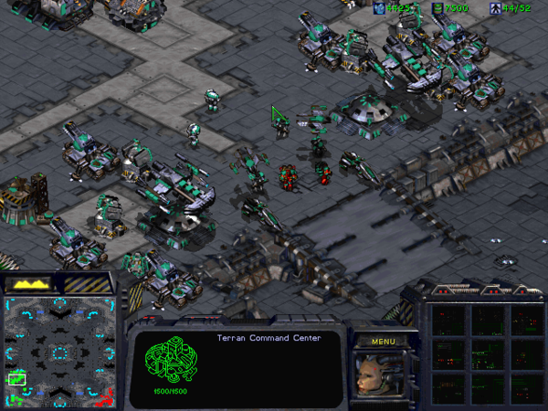
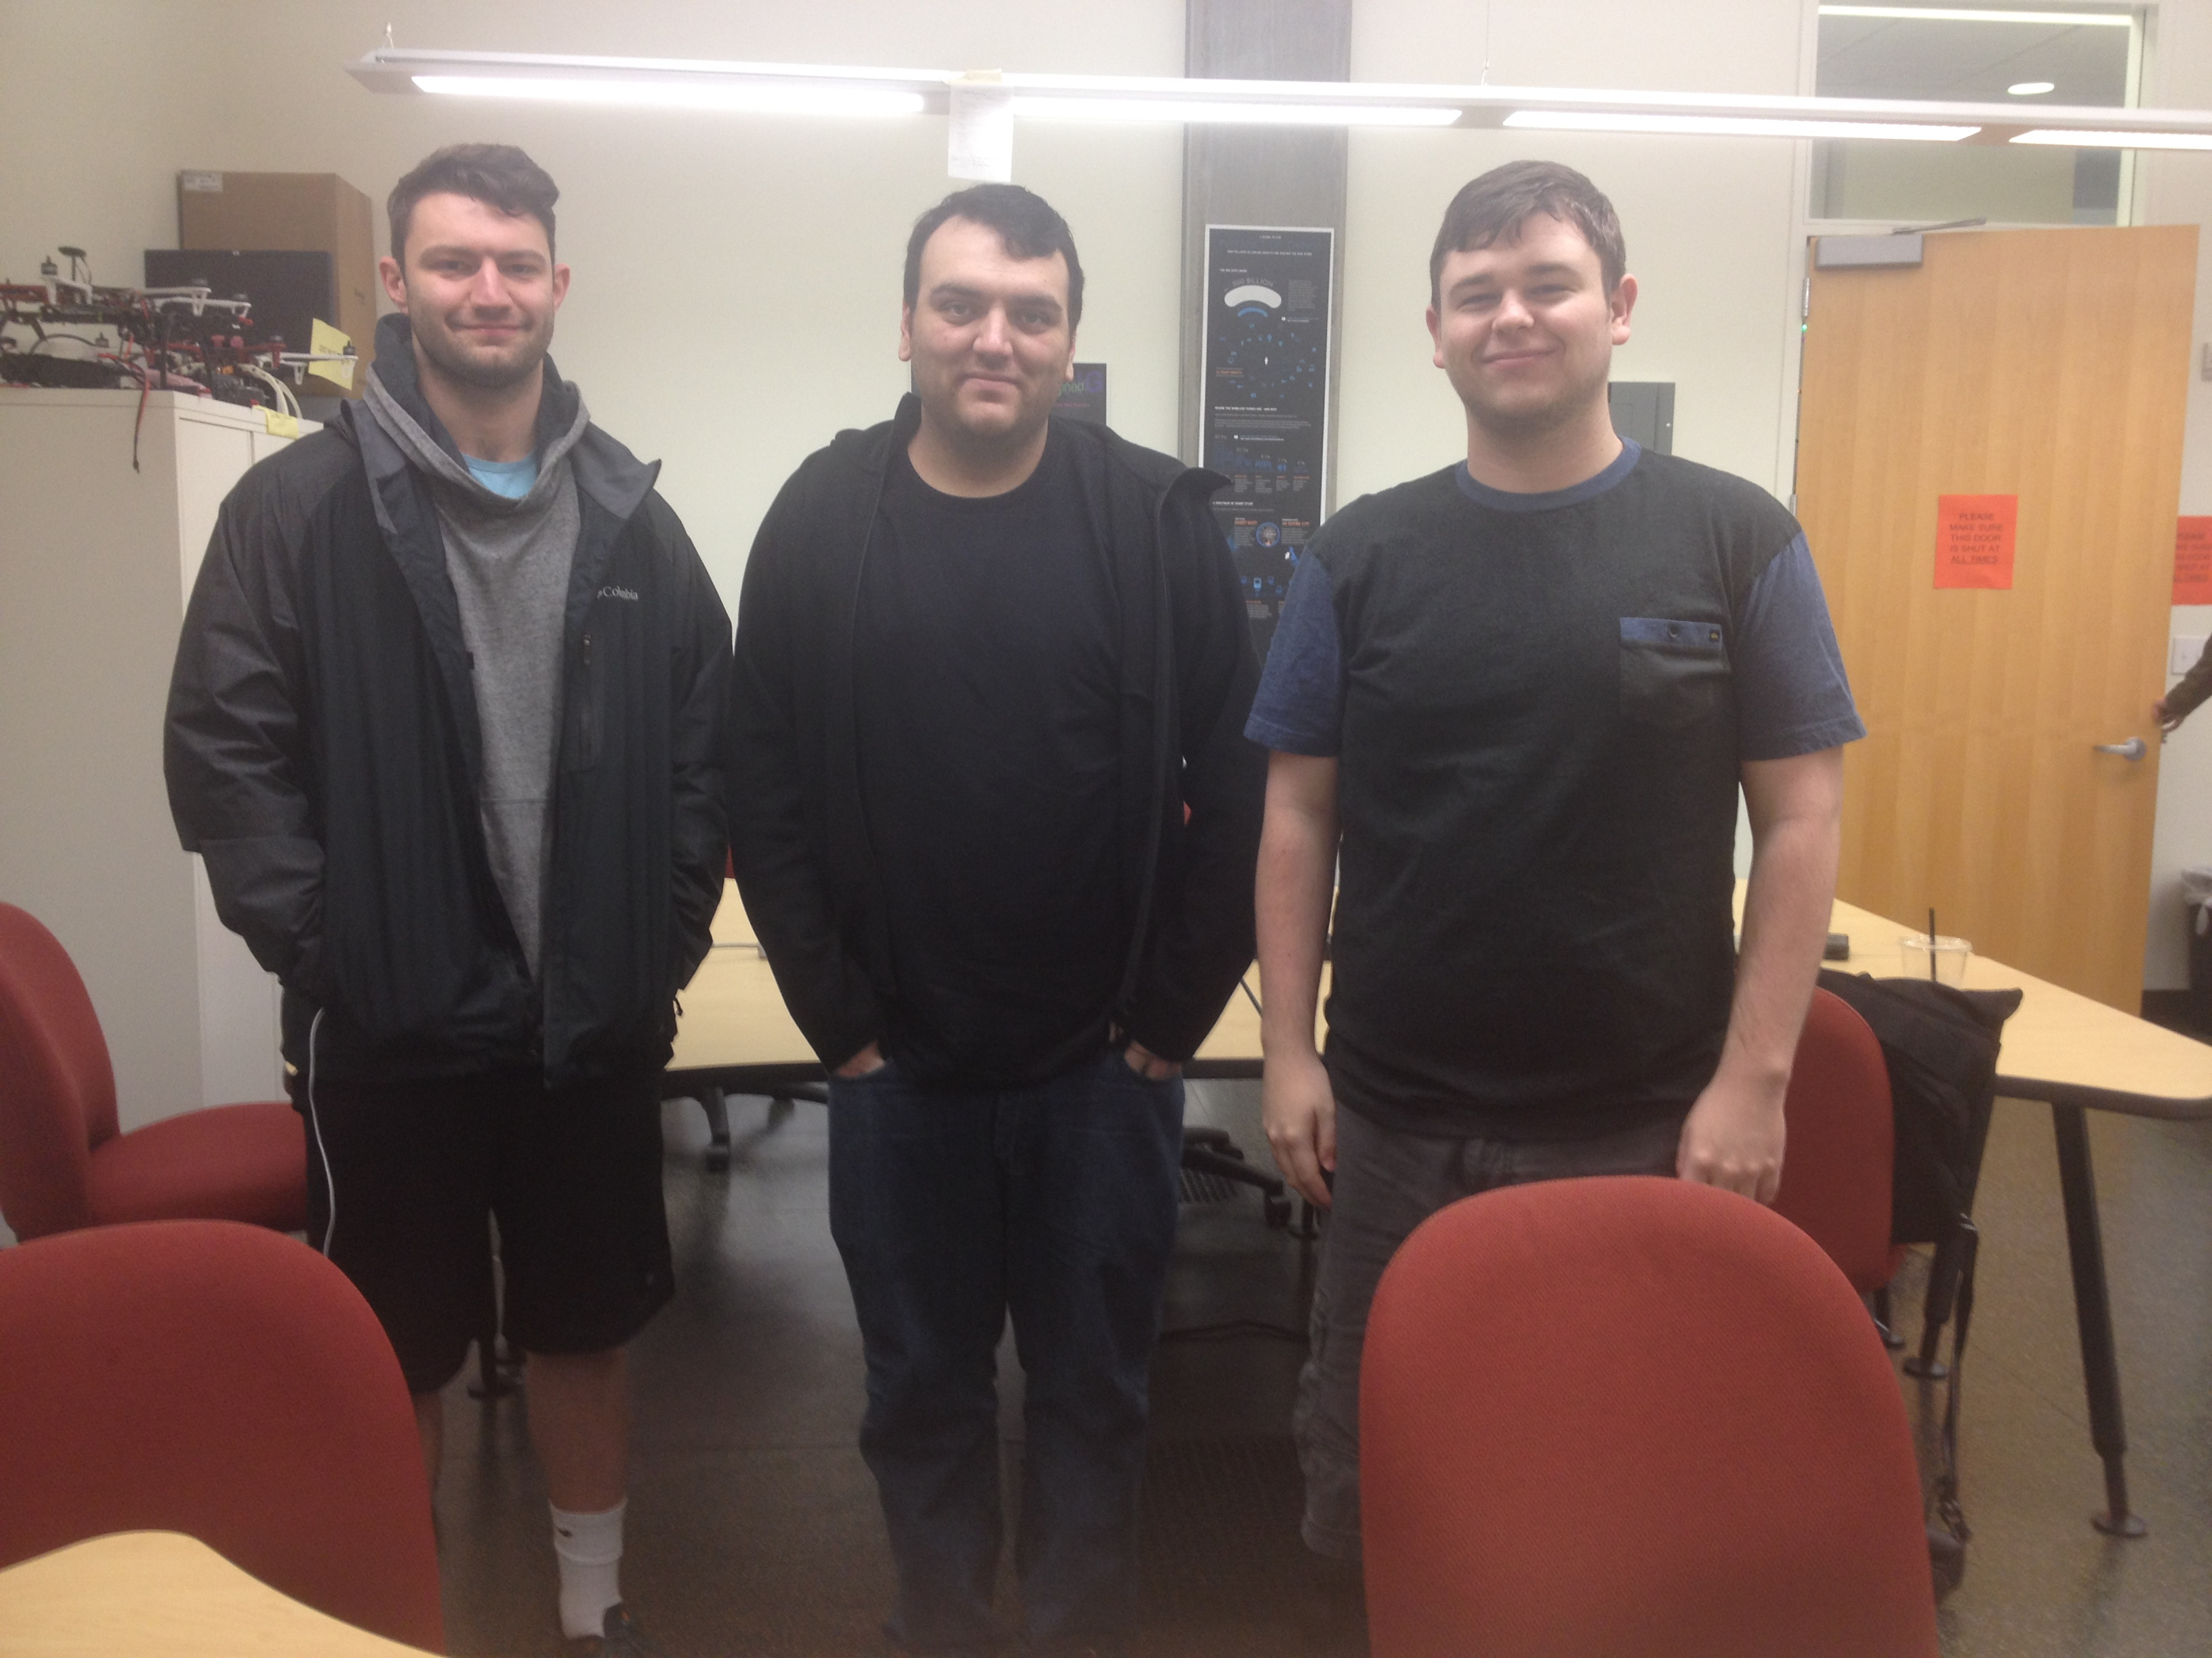
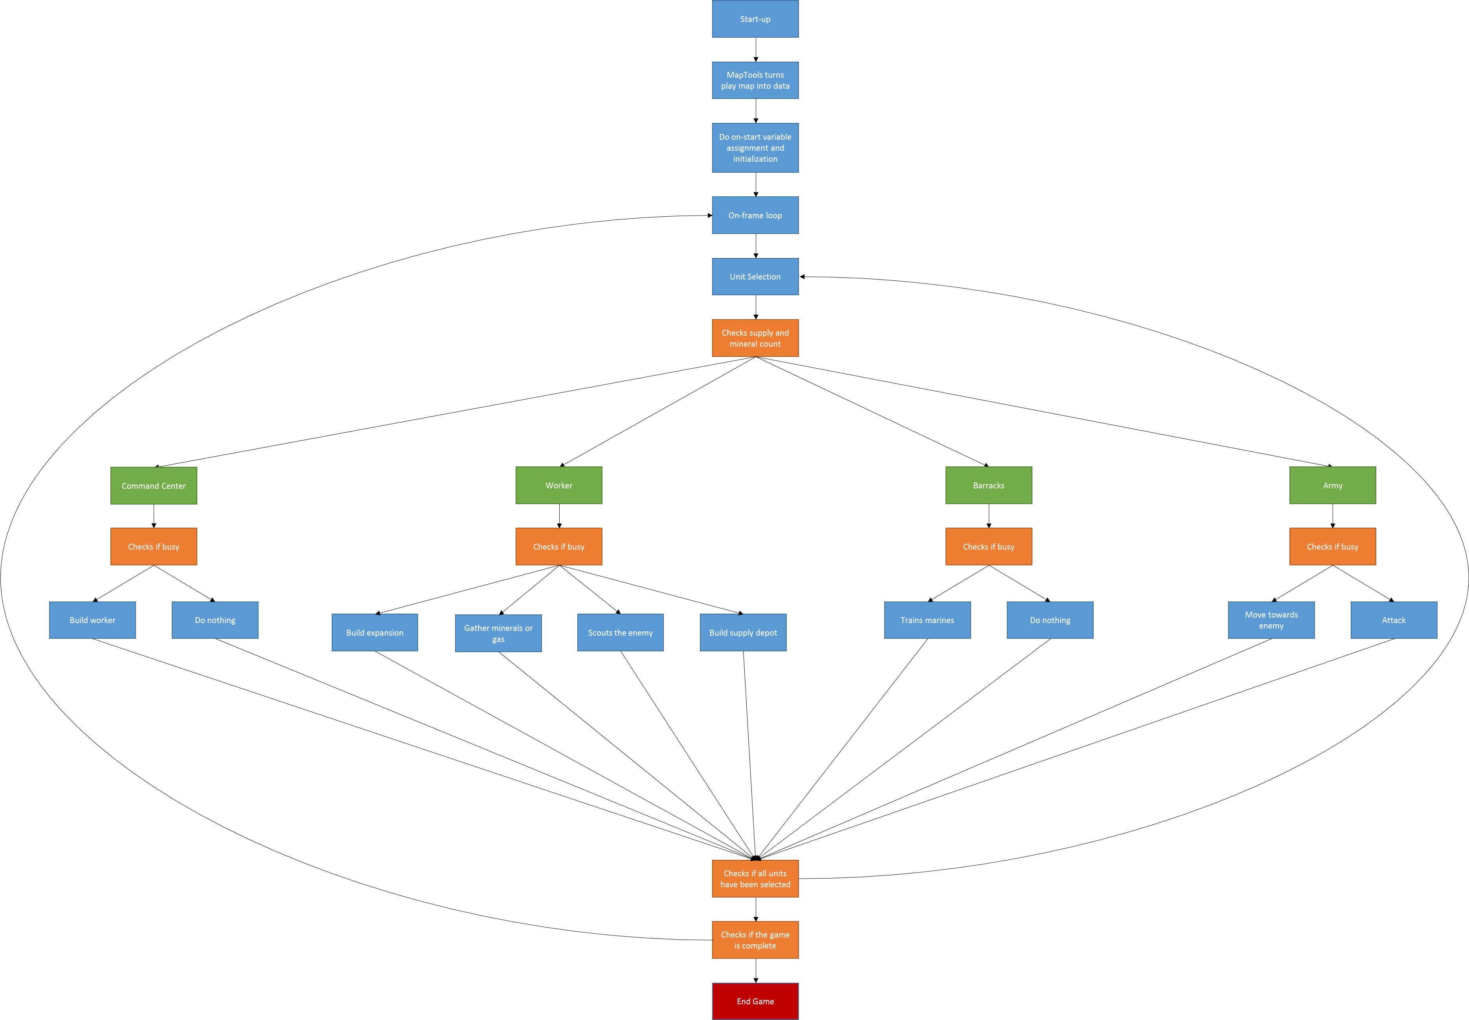
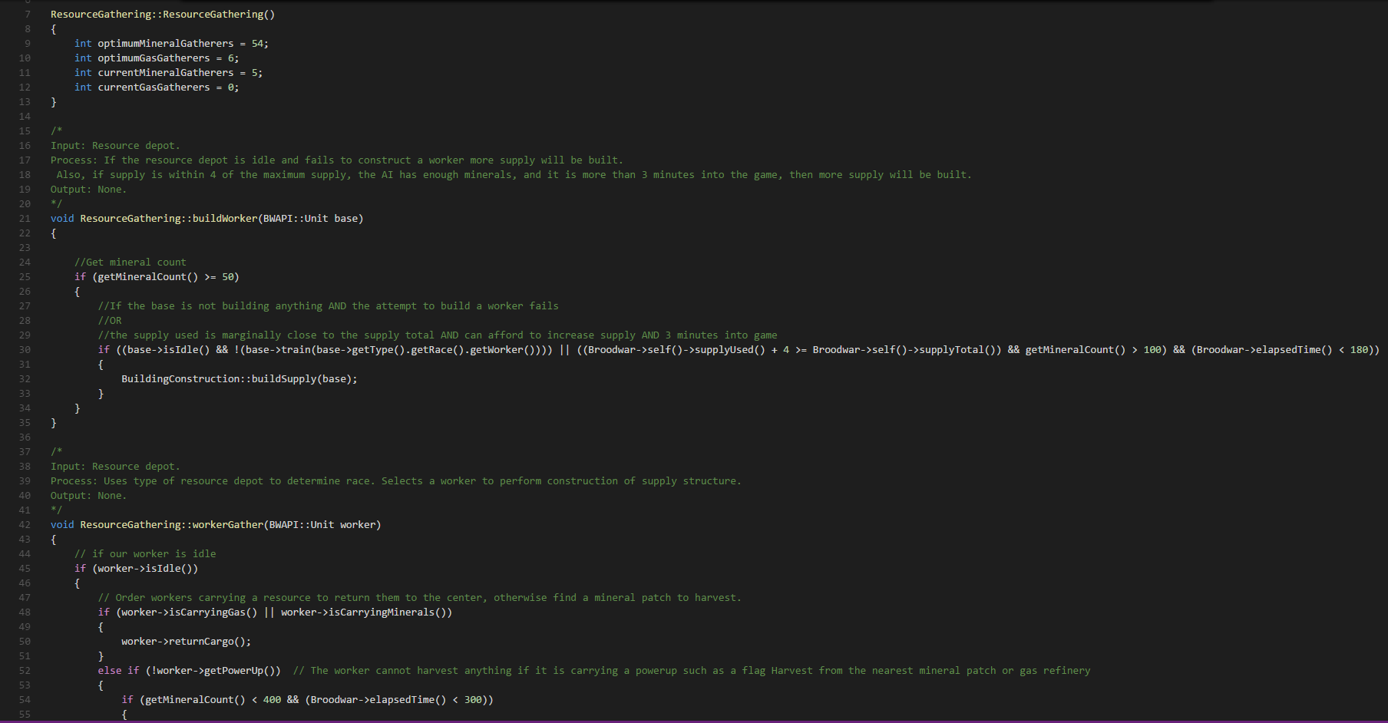
Project Devai
Project Description
Individuals Involved
A Template StarCraft Artificial Intelligence:
Creating an example AI for others to learn from.
Library Building
The purpose of the library is to create an easier way for students to familiarize themselves with the API used to interact with the game. It covers most of the important parts required of the game to play and win a match. It will also help as a starting point for others who want to include more complicated functions into the library as well as those who just want to take bits and pieces from it. The following are classes that are the focus of our library.
Economy Class
Builds workers to gather resources and construct buildings
Gets count of in game resources
Construction Class
Constructs the buildings in the game
Unit Action Class
Gives individual commands to a unit
Used for buildings to train and units to move and attack
Map Tools Class
Extension used to convert map to data to be used by agent
Main use for expansion and scouting
Player Class
Storing of variables to track events and triggers that would otherwise be global variables
Goals
Create example AI for future club members with an interest in machine learning to use as a starting example
Create extensive library of functions to simplify interaction with API
Build an example AI using the created library to show off functions and give an example to work from
Document functions and classes for further understanding as well as include installation process and setup for the AI in game
StarCraft Brood War
A real-time strategy developed by Blizzard Entertainment
Requires reactionary plays using quick thinking to analyze the best strategy
Most games require analysis of the enemy’s chosen strategy in real-time.
Win condition is defined by the enemy being destroyed or forfeiting.
Documentation
We will be including documentation to further explain the purposes, requirements, and effects of the classes and functions in our code. This is stored in a readme within the project source code. The readme will also include a detailed guide on any additional files that need to be downloaded to make all of our code work. Finally we will be including the instructions required to setup the environment to code in as well as how to transfer files to the appropriate game directory.
Simple AI
Our AI will be fairly simple as it is mainly an example and a way to show off the different features in our library. We chose one specific race and had some simple conditionals to do the following:
Train workers
Workers are then sent to gather and construct any buildings
Build supply depots
This is to increase the number of units that can be on the field
Build a barracks
Required to train military, specifically marines
Train marines
Army units used to attack the enemy
Find and build an expansion
Used to increase economy and efficiency
Select all army units
Scout the enemy
Uses terrain analyzer to systematically find the enemy
Attack the enemy base repeatedly until victory
From left to right: Brandon Chatham, Jacob Broderick, Kristen Patterson
Kristen Patterson
Computer Science Applied
patterkr@oregonstate.edu
Jacob Broderick
Computer Science Applied
broderij@oregonstate.edu
Brandon Chatham
Computer Science Applied
chathamb@oregonstate.edu
Dr. Alan Fern (client)
Associate Head of Research and Professor at Oregon State University
We all undertook this project because we either had a major pertaining to video games or had an interest in AI and how it is developed. Our client also teaches and researches machine learning.
Notes:
If tri-fold mounting at SMS – make sure no text or image is in-between the two vertical guide lines; this space will be cut away. To view the vertical guide lines: Select “View” from the main menu, select “Guides” from the pull down menu, and lastly select “Static Guides”.

